Slide 1
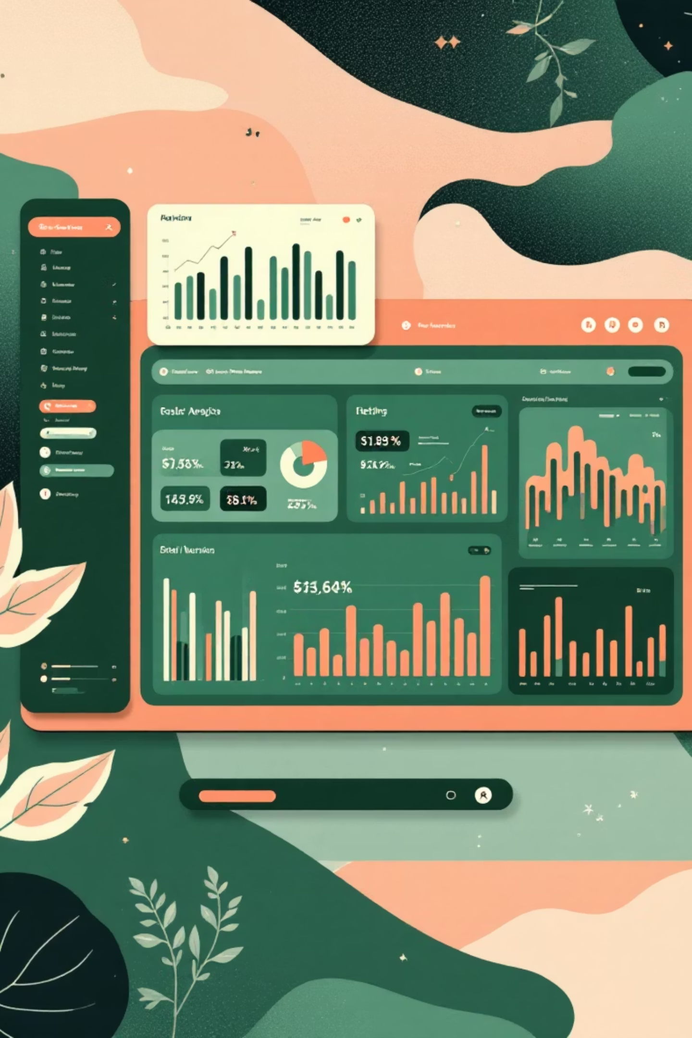
Customer Shopping Behavior Analysis
Uncovering insights from 3,900 purchases to guide strategic business decisions

Slide 2
PROJECT SCOPE
Dataset Overview
3,900
18
37
Total Purchases
Data Points
Missing Values
Transactions analyzed
Features per transaction
In review ratings only
Demographics
Purchase Details
Behavior Metrics
Age, gender, location, subscription status
Item, category, amount, season, size, color
Discounts, frequency, ratings, shipping type

Slide 3



PYTHON ANALYSIS
Data Preparation & Cleaning
01
Data Loading
Imported dataset using pandas
02
Exploration
Structure check and summary statistics
03
Missing Data
Imputed review ratings by category median
04
Dropped redundant promo_code_used column after consistency check
Standardization
Renamed columns to snake_case
05
Feature Engineering
Created age groups and frequency metrics
06
Database Integration
Loaded to PostgreSQL for SQL analysis

Slide 4

SQL INSIGHTS
Revenue by Gender
Analyzed total revenue generated by male versus female customers to identify gender-based spending patterns
Understanding gender preferences helps tailor marketing campaigns and product positioning

Slide 5

High-Value Discount Users
Key Finding
Identified customers who used discounts but still spent above average purchase amounts
These customers represent optimal targets for promotional campaigns
Strategic Insight
Marketing Opportunity
Discount-sensitive customers can still be high spenders
Target this segment with exclusive offers

Slide 6
Product Performance Analysis
Top 5 Products
Shipping Preferences
Discount Dependency
Highest average review ratings identified
Standard vs Express purchase amount comparison
5 products with highest discounted purchase rates

Slide 7
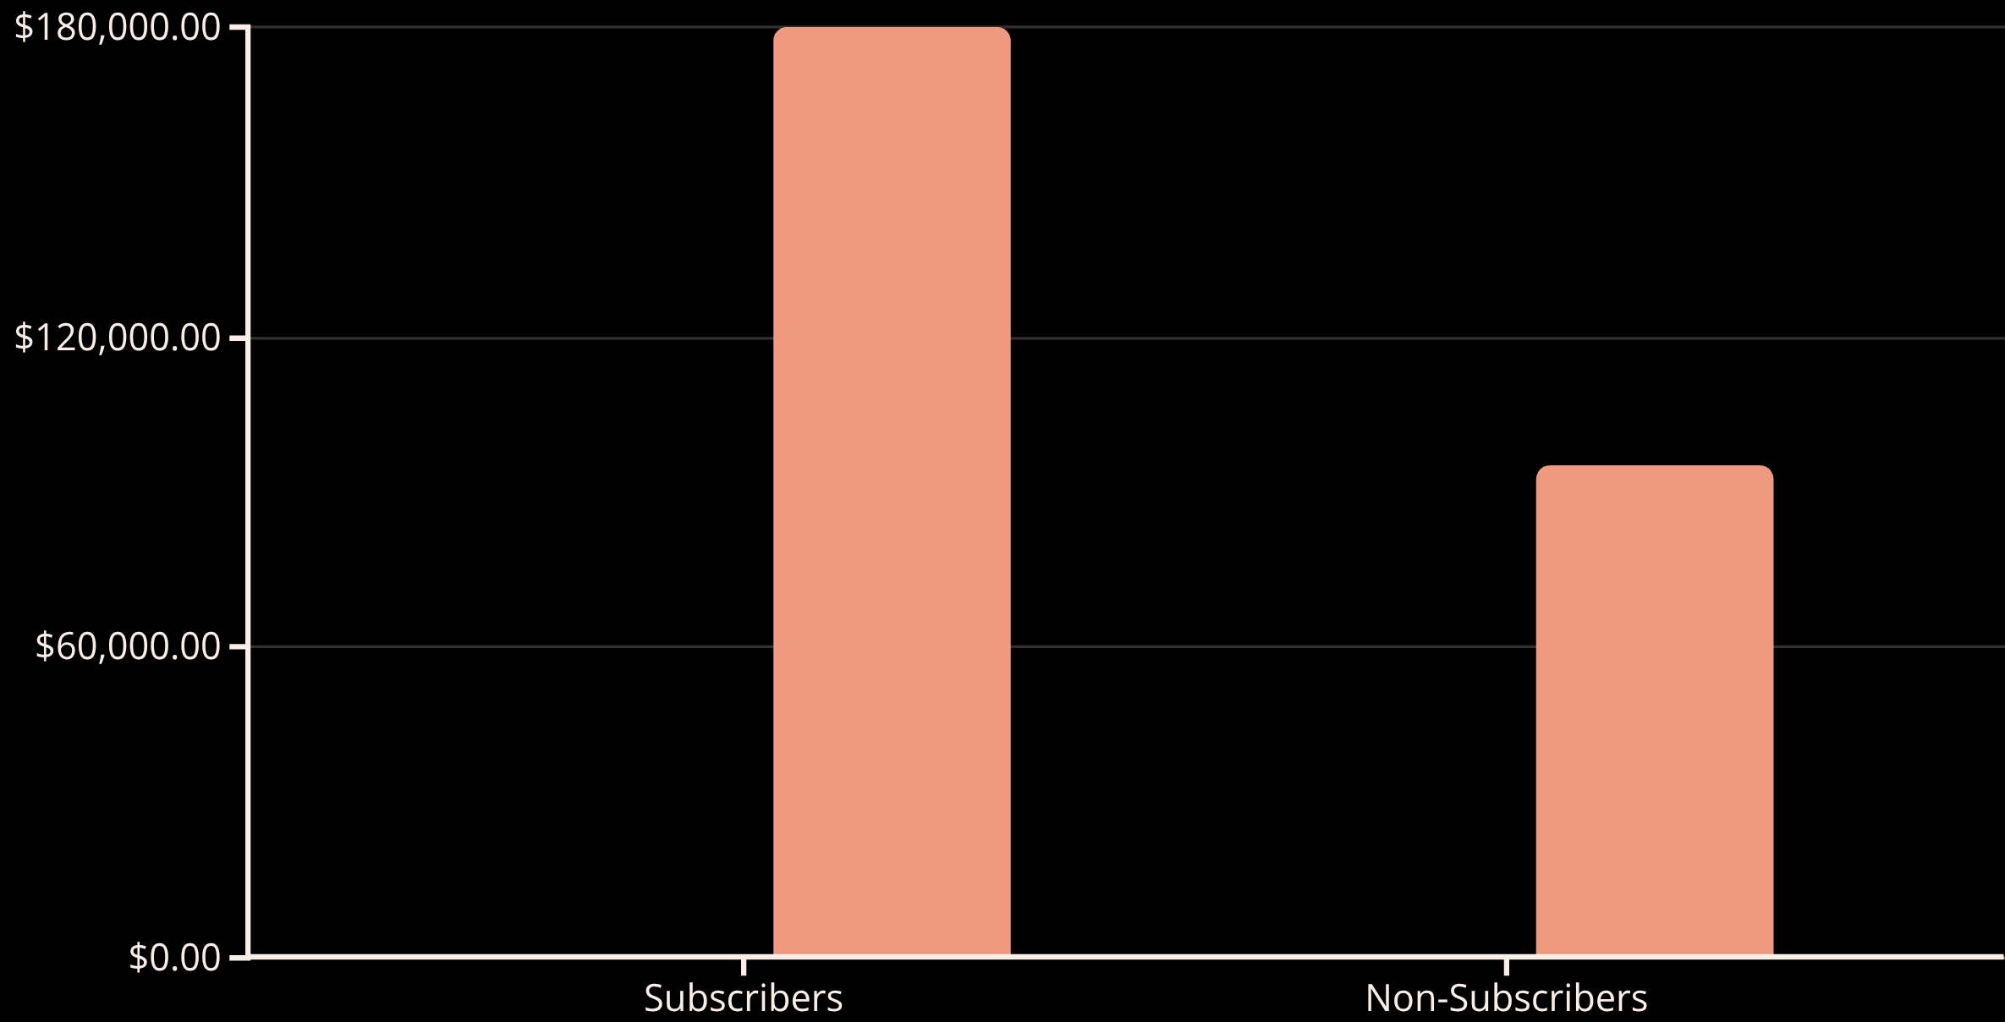
SUBSCRIPTION ANALYSIS
Subscribers vs Non-Subscribers
Average Spend
Total Revenue
Key Insight
Repeat Buyer Correlation
Subscribers show significantly higher average spend and total revenue contribution
Customers with >5 purchases are more likely to subscribe

Slide 8



Customer Segmentation
Loyal
Returning
New
Classified customers based on purchase history to identify engagement levels and lifetime value potential

Slide 9
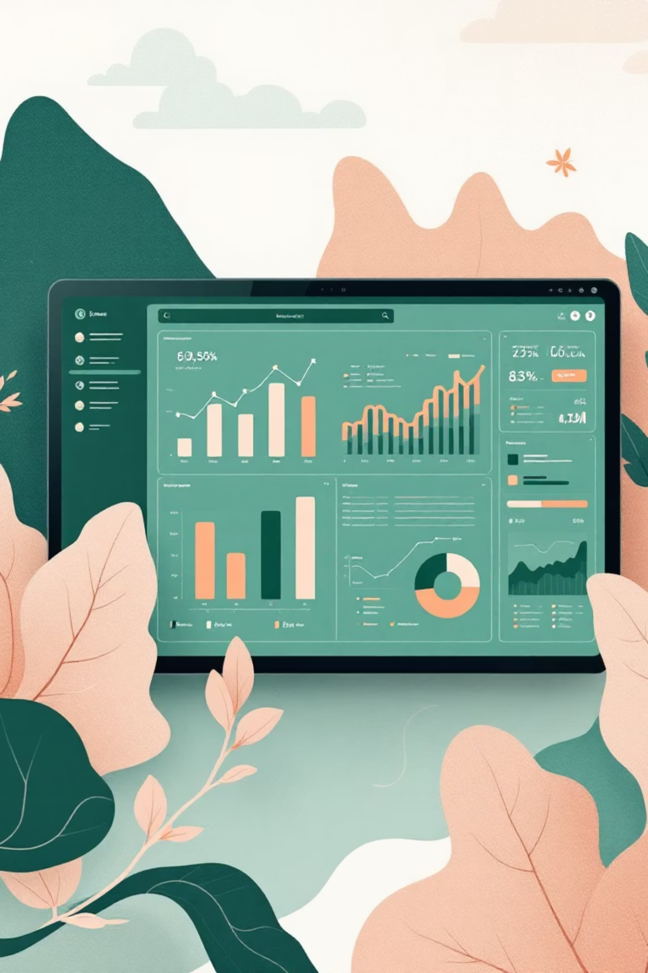
POWER BI DASHBOARD
Interactive Visual Analytics
Age Group Revenue
Top 3 Per Category
Total contribution by demographic
Most purchased products
Interactive Filters
Dynamic data exploration

Slide 10





ACTION ITEMS
Business Recommendations
Boost Subscriptions
Promote exclusive benefits for subscribers
Loyalty Programs
Reward repeat buyers to increase retention
Review Discount Policy
Balance sales boosts with margin control
Product Positioning
Highlight top-rated items in campaigns
Targeted Marketing
Focus on high-revenue segments

